Slide 1
Artificial Intelligence and Machine Learning
1.

Slide 2

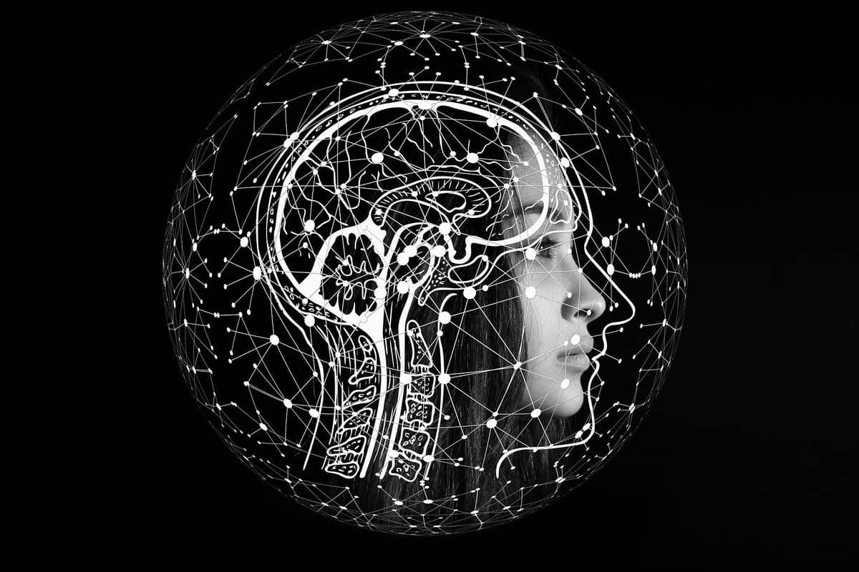
Artificial Intelligence:
It's the stimulation of human intelligence processes by machines especially computer systems.

Slide 3

Machine Learning:
It is a type of AI that allows software applications to become more accurate at predicting outcomes without being explicitly programmed to do so.

Slide 4
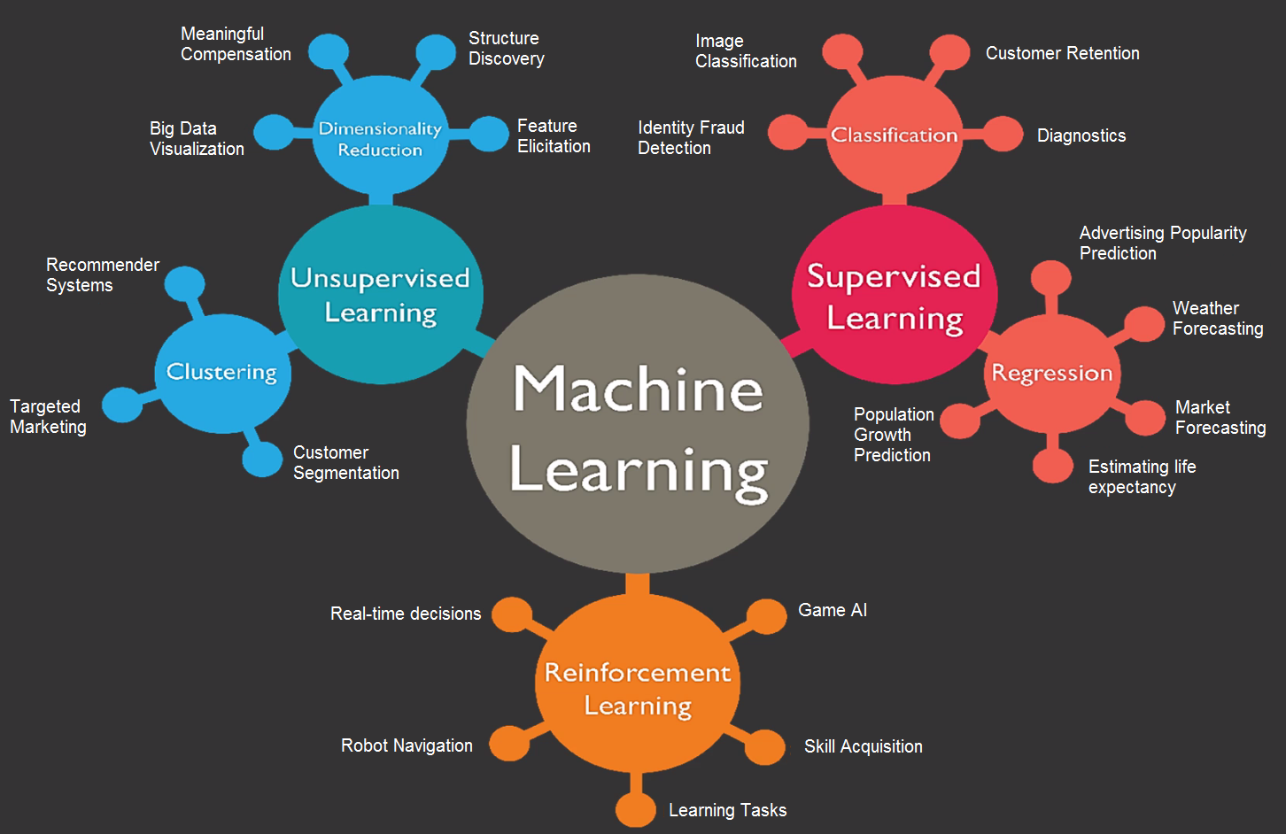

Slide 5
SL, USL, RL
2.

Slide 6

Supervisor Learning :
* Learning from others
* Features and labels
* Classification and Regression
Example : learning something new from a teacher and vise versa, here only two subjects are involved in the process thus acting as features and labels

Slide 7

Unsupervised Learning :
* Learning on your own
* Only features
* Association
Example : learning something new by oneself, using just one’s resources

Slide 8

Reinforcement Learning :
Self interpreting based on the system of rewards and penalty, learned through trial and error seeking maximum rewards.
Example : Dog is given a treat on doing the said action correctly , if the dog doesn’t do the said action the it won’t get any treat.

Slide 9
Regression and Classification in Supervised Learning
3.

Slide 10
Regression :
Regression is a technique for investigating the relationship between independent variables or features and a dependent variable or outcome. It's used as a method for predictive modelling in machine learning, in which an algorithm is used to predict continuous outcomes.
Classification :
Classification is the task of predicting a discrete class label.
in general, is a function that weighs the input features so that the output separates one class into positive values and the other into negative values, that is categorical segregation .

Slide 11
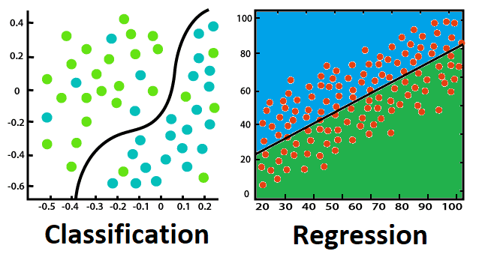

Slide 12
Linear Regression:
In this process, a relationship is established between independent and dependent variables by fitting them to a line . This line is known as the regression line and represented by a linear equation y = mx+c
Logistic Regression:
This method is used to estimate discrete values from a set of independent variables. It helps predict the probability of an event by fitting data to a logic function.
Decision tree:
This is a supervised learning algorithm that is used for classification problems. In this algorithm we split the population into two /more homogenous sets based on the most significant attributes/ independent variables.

Slide 13
SVM:
In this algorithm, we plot raw data as points in an n-dimensional space. The value of each feature is tied to a particular coordinate, making it easy to classify the data.
Naive Bayes :
A Naive Bayes classifier assumes that the presence of a particular feature in a class is unrelated to the presence of any other feature.
KNN :
This can be applied to both classification and regression problems. It stores all the cases and classifies any new cases by taking a majority vote of its k neighbours. The case is then assigned to the class with which it has the most in common.

Slide 14
K-Means :
In the unsupervised learning algorithm, data sets are classified into a particular no. of cluster are homogenous from the data in other clusters
Random Forest:
A collective of decision trees is random forest. To classify new object based on its attributes, each tree is classified and the tree votes for that class. The forest chooses the classification having the most votes.

Slide 15
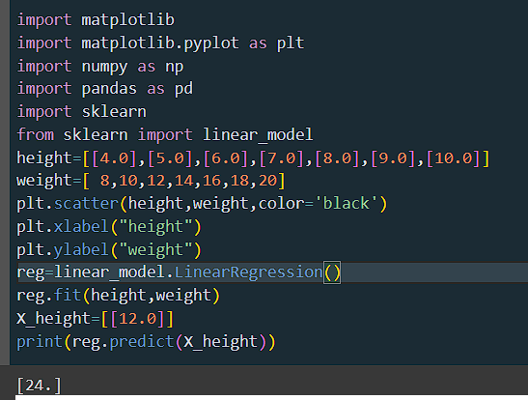
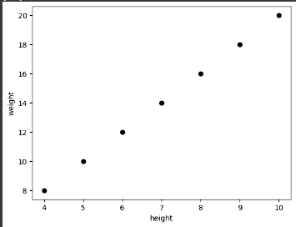
LINEAR REGRESSION

Slide 16
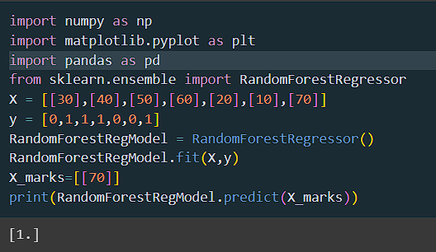
RANDOM FOREST

Slide 17
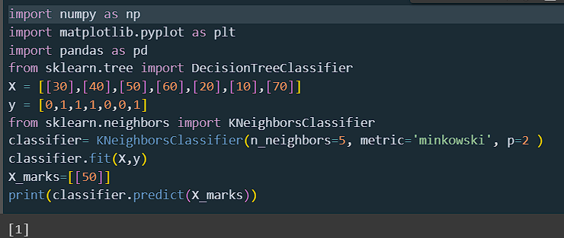
KNN

Slide 18
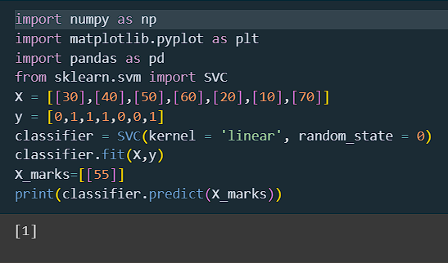
SVM

Slide 19
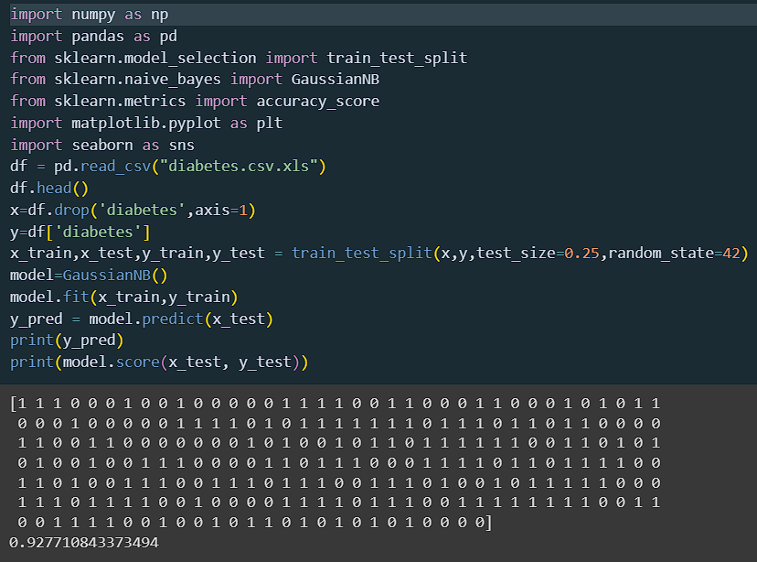
NAIVE BAYES

Slide 20
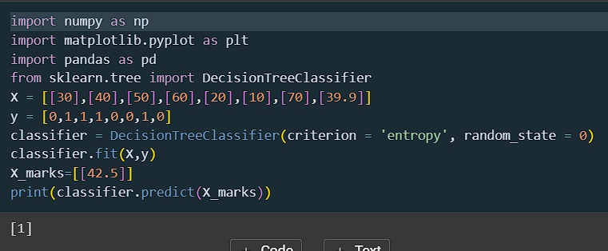
DECISION TREE

Slide 21
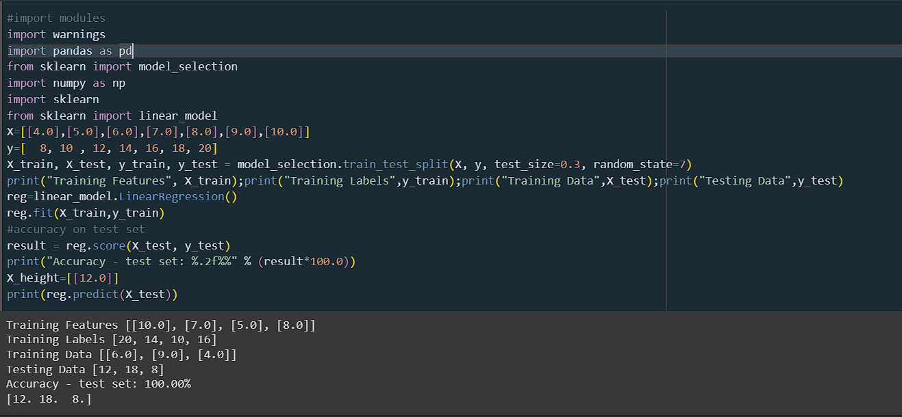

Slide 22
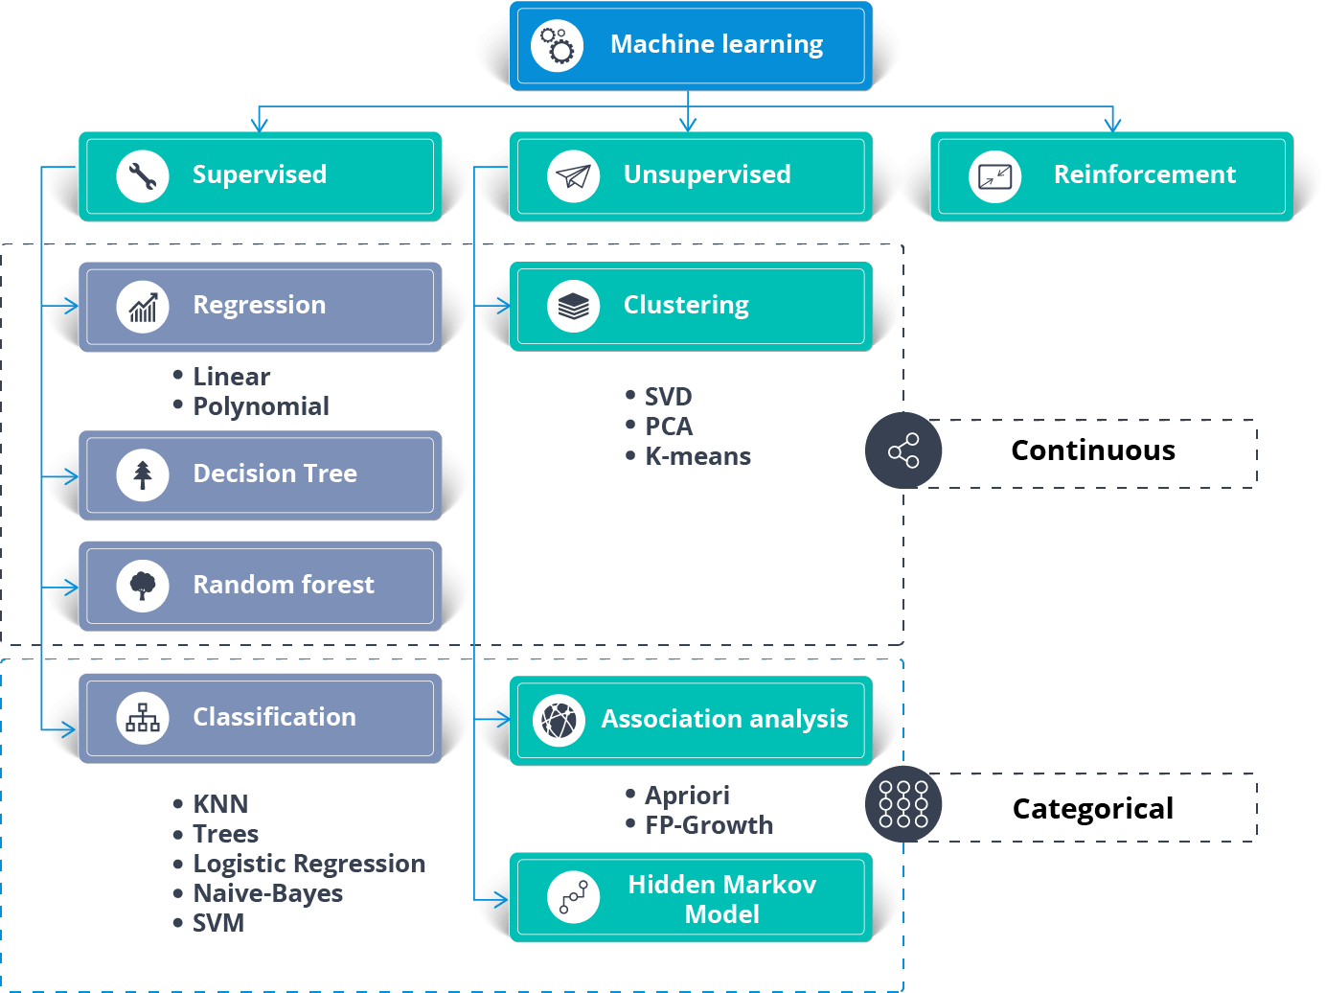

Slide 23
Features, Labels, Model in ML with maths
3.

Slide 24
Features : input data
Labels : output data
Models : mathematical expression created from the given dataset using machine learning algorithm, thus helps in prediction for a new input.
Eg: flowchart of prediction model
Eg:
machine Learning :
y = 4x
Features (x)
NEW VALUE
23
INPUT
Predicted output
1, 2, 3, 4, 5, 6….10
ML Algorithms
Model
4, 8, 12, 16, 20, 24,..40
OUTPUT
PREDICTED OUTPUT
Labels (y)
92

Slide 25
Python Libraries
4.

Slide 26
scikit learn : it is a machine learning library containing machine learning algorithms.
matplotlib : it is a python library used to represent numeric data in the visual formats.
pandas : this library is useful for cleaning the data or like organizing the data
numpy : it is the number processing library in python
scipy : it is the scientific number processing library in python

Slide 27
Methods in ML Algorithm
5.

Slide 28
fit( ) : In this method the features and labels are taken to create models.
predict( ) : This will perform a prediction for each test instance and it usually accepts only a single input (X). The predicted values of the provided test instances will be returned in a form of an output of an array or sparse matrix.
score( ) : This method is used to find the accuracy of the predicted data to that of the actual data.

